Slide 1

Navigation of Mobile Robots (Probabilistic Robotics) (Localization and Mapping)
Department of Mechanical Engineering and Automation
Dr. Chen Haoyao
hychen5@hitsz.edu.cn

Slide 2
What Focus?
Chapter 1
Demonstration 1: Monocular SLAM
Demonstration 2: Laser SLAM
Demonstration 3:
Demonstration 4：Airplane

Slide 3
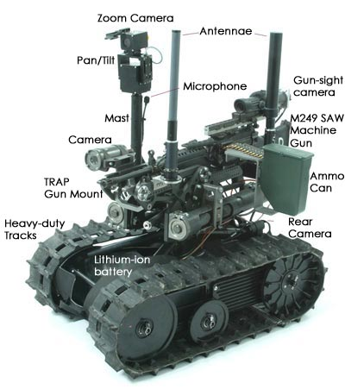
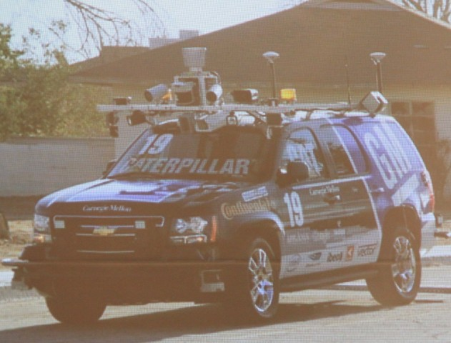
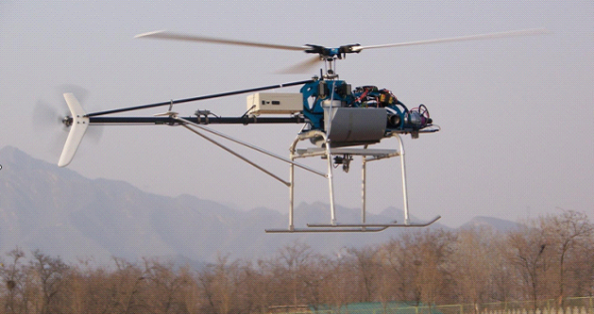
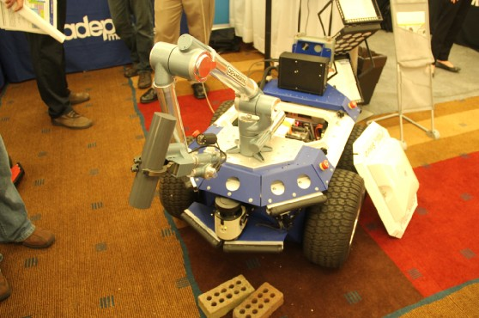
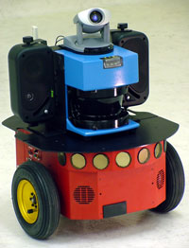
Chapter 1
Uncertainty?

Slide 4

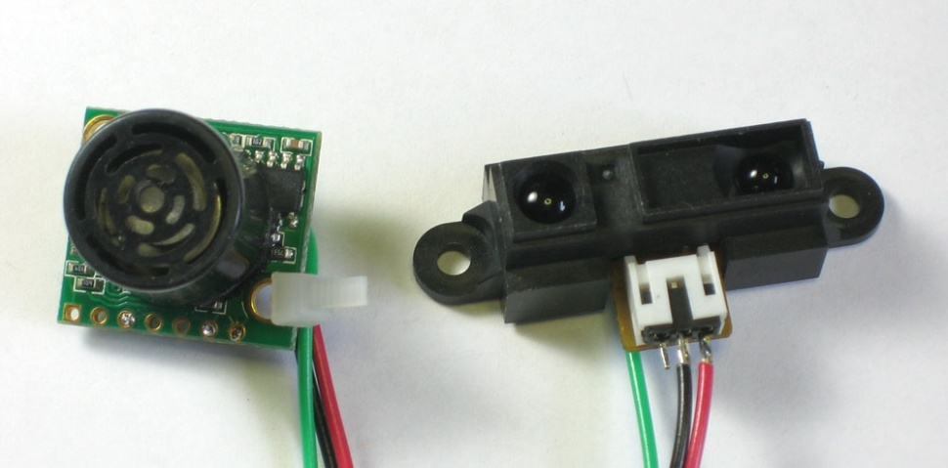

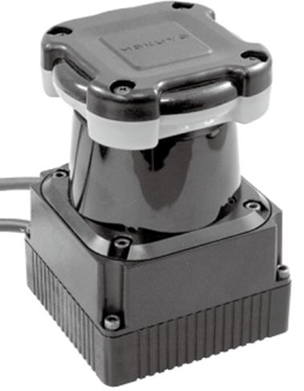
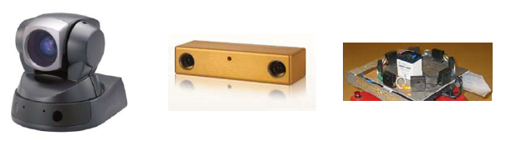
Chapter 1
Uncertainty?

Slide 5
Probabilistic Robotics
Chapter 1
Key idea: Explicit representation of uncertainty using the calculus of probability theory
Perception = state estimation
Action = utility optimization

Slide 6
Global Localization Example
Chapter 1
Localization?
Where am I?
Stupid Guy

Slide 7
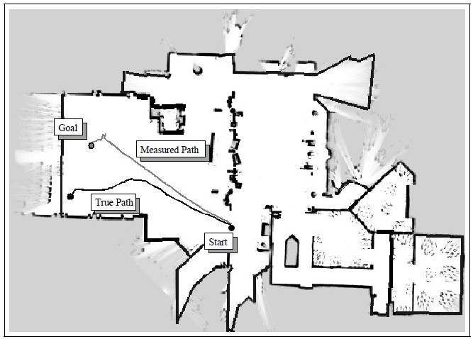
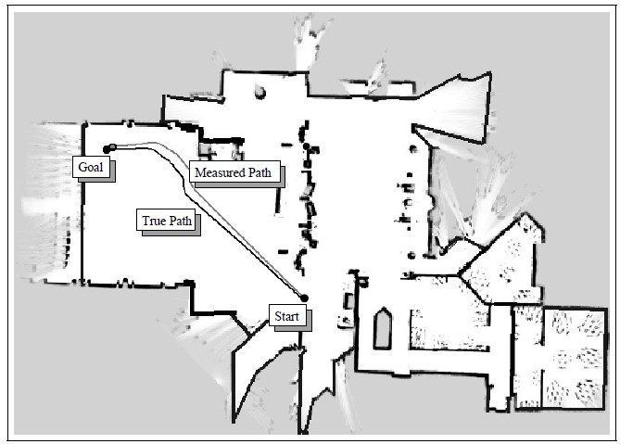
Chapter 1
Coastal Navigation Example
coastal space
Open space
small error
Big error

Slide 8
Axioms of Probability Theory
Chapter 2
Pr(A) denotes probability that proposition A is true.

Slide 9
A Closer Look at Axiom 3
Chapter 2
B

Slide 10
Using the Axioms
Chapter 2

Slide 11
Discrete Random Variables
Chapter 2
X denotes a random variable.
X can take on a countable number of values in {x₁, x₂, …, x_{n}}.
P(X=x_{i}), or P(x_{i}), is the probability that the random variable X takes on value x_{i}.
P( ) is called probability mass function.
E.g.
.

Slide 12
Continuous Random Variables
Chapter 2
X takes on values in the continuum.
p(X=x), or p(x), is a probability density function.
E.g.
p(x)
x

Slide 13
Joint and Conditional Probability
Chapter 2
P(X=x and Y=y) = P(x,y)
If X and Y are independent then P(x,y) = P(x) P(y)
P(x | y) is the probability of x given y P(x | y) = P(x,y) / P(y) P(x,y) = P(x | y) P(y)
If X and Y are independent then P(x | y) = P(x)

Slide 14
Law of Total Probability, Marginals
Chapter 2
Discrete case
Continuous case

Slide 15
Bayes Formula
Chapter 2

Slide 16
Normalization
Chapter 2
Algorithm:

Slide 17
Bayes Rule with Background Knowledge
Chapter 2

Slide 18
Conditioning
Chapter 2
Total probability:

Slide 19
Conditional Independence
Chapter 2
equivalent to
and

Slide 20
Simple Example of State Estimation
Chapter 2
Suppose a robot obtains measurement z
What is P(open|z)?

Slide 21
Causal vs. Diagnostic Reasoning
Chapter 2
P(open|z) is diagnostic.
P(z|open) is causal.
Often causal knowledge is easier to obtain.
Bayes rule allows us to use causal knowledge:
count frequencies!

Slide 22
Example
Chapter 2
P(z|open) = 0.6 P(z|¬open) = 0.3
P(open) = P(¬open) = 0.5
z raises the probability that the door is open.

Slide 23
Combining Evidence
Chapter 2
Suppose our robot obtains another observation z₂.
How can we integrate this new information?
More generally, how can we estimate P(x| z₁...z_{n} )?

Slide 24
Recursive Bayesian Updating
Chapter 2
Markov assumption: z_{n} is independent of z₁,...,z_{n-1} if we know x.

Slide 25
Example: Second Measurement
Chapter 2
P(z₂|open) = 0.5 P(z₂|¬open) = 0.6
P(open|z₁)=2/3
z₂ lowers the probability that the door is open.

Slide 26
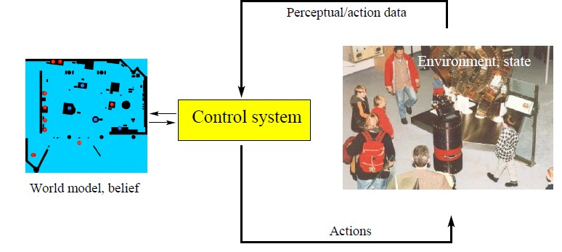
Actions
Chapter 2
Often the world is dynamic since
actions carried out by the robot,
actions carried out by other agents,
or just the time passing by
changing the world.
How can we incorporate such actions?

Slide 27
Typical Actions
Chapter 2
The robot turns its wheels to move
The robot uses its manipulator to grasp an object
…
Actions are never carried out with absolute certainty.
In contrast to measurements, actions generally increase the uncertainty.

Slide 28
Modeling Actions
Chapter 2
To incorporate the outcome of an action u into the current “belief”, we use the conditional pdf
P(x|u,x’)
This term specifies the pdf that executing u changes the state from x’ to x.

Slide 29
Example: Closing the door
Chapter 2

Slide 30
State Transitions
Chapter 2
P(x|u,x’) for u = “close door”:
If the door is open, the action “close door” succeeds in 90% of all cases.

Slide 31
Integrating the Outcome of Actions
Chapter 2
Continuous case:
Discrete case:

Slide 32
Example: The Resulting Belief
Chapter 2

Slide 33
Bayes Filters: Framework
Chapter 2
Given:
Stream of observations z and action data u:
Sensor model P(z|x).
Action model P(x|u,x’).
Prior probability of the system state P(x).
Wanted:
Estimate of the state X of a dynamical system.
The posterior of the state is also called Belief:

Slide 34
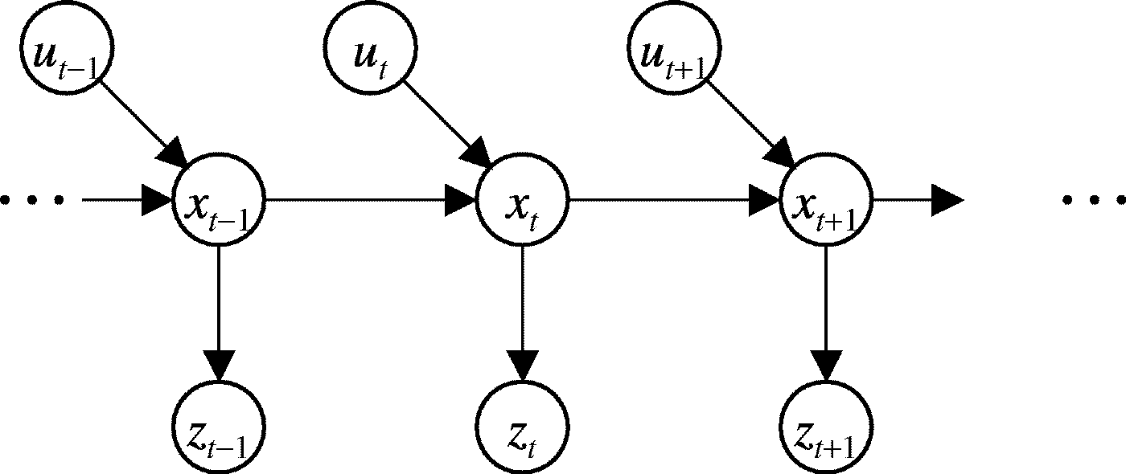
Markov Assumption
Chapter 2
Underlying Assumptions
Static world
Independent noise
Perfect model, no approximation errors

Slide 35
Bayes Filters
z = observation
u = action
x = state
Bayes
Markov
Total prob.
Markov
Markov

Slide 36
Bayes Filter Algorithm
Chapter 2
Algorithm Bayes_filter( Bel(x),d ):
η=0
If d is a perceptual data item z then
For all x do
For all x do
Else if d is an action data item u then
For all x do
Return Bel’(x)

Slide 37
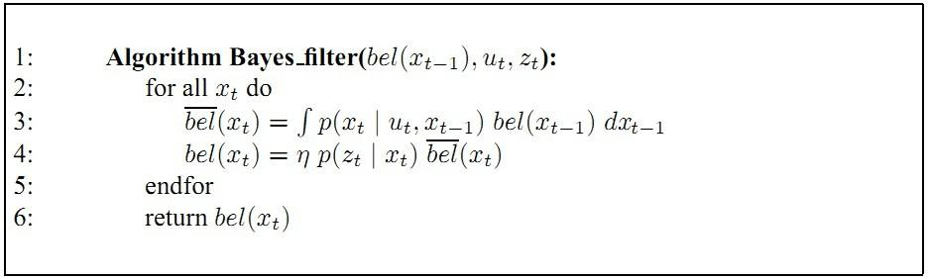

Slide 38
Bayes Filters are Familiar!
Chapter 2
Kalman filters
Particle filters
Hidden Markov models
Dynamic Bayesian networks
Partially Observable Markov Decision Processes (POMDPs)

Slide 39
Summary
Chapter 2
Bayes rule allows us to compute probabilities that are hard to assess otherwise.
Under the Markov assumption, recursive Bayesian updating can be used to efficiently combine evidence.
Bayes filters are a probabilistic tool for estimating the state of dynamic systems.

Slide 40
Homework
Chapter 1，2
1. Give the introduction of Kalman Filter. (First, Chinese will be OK)
2. Mathematically derive the Bayes Filter. (E)

